Slide 1
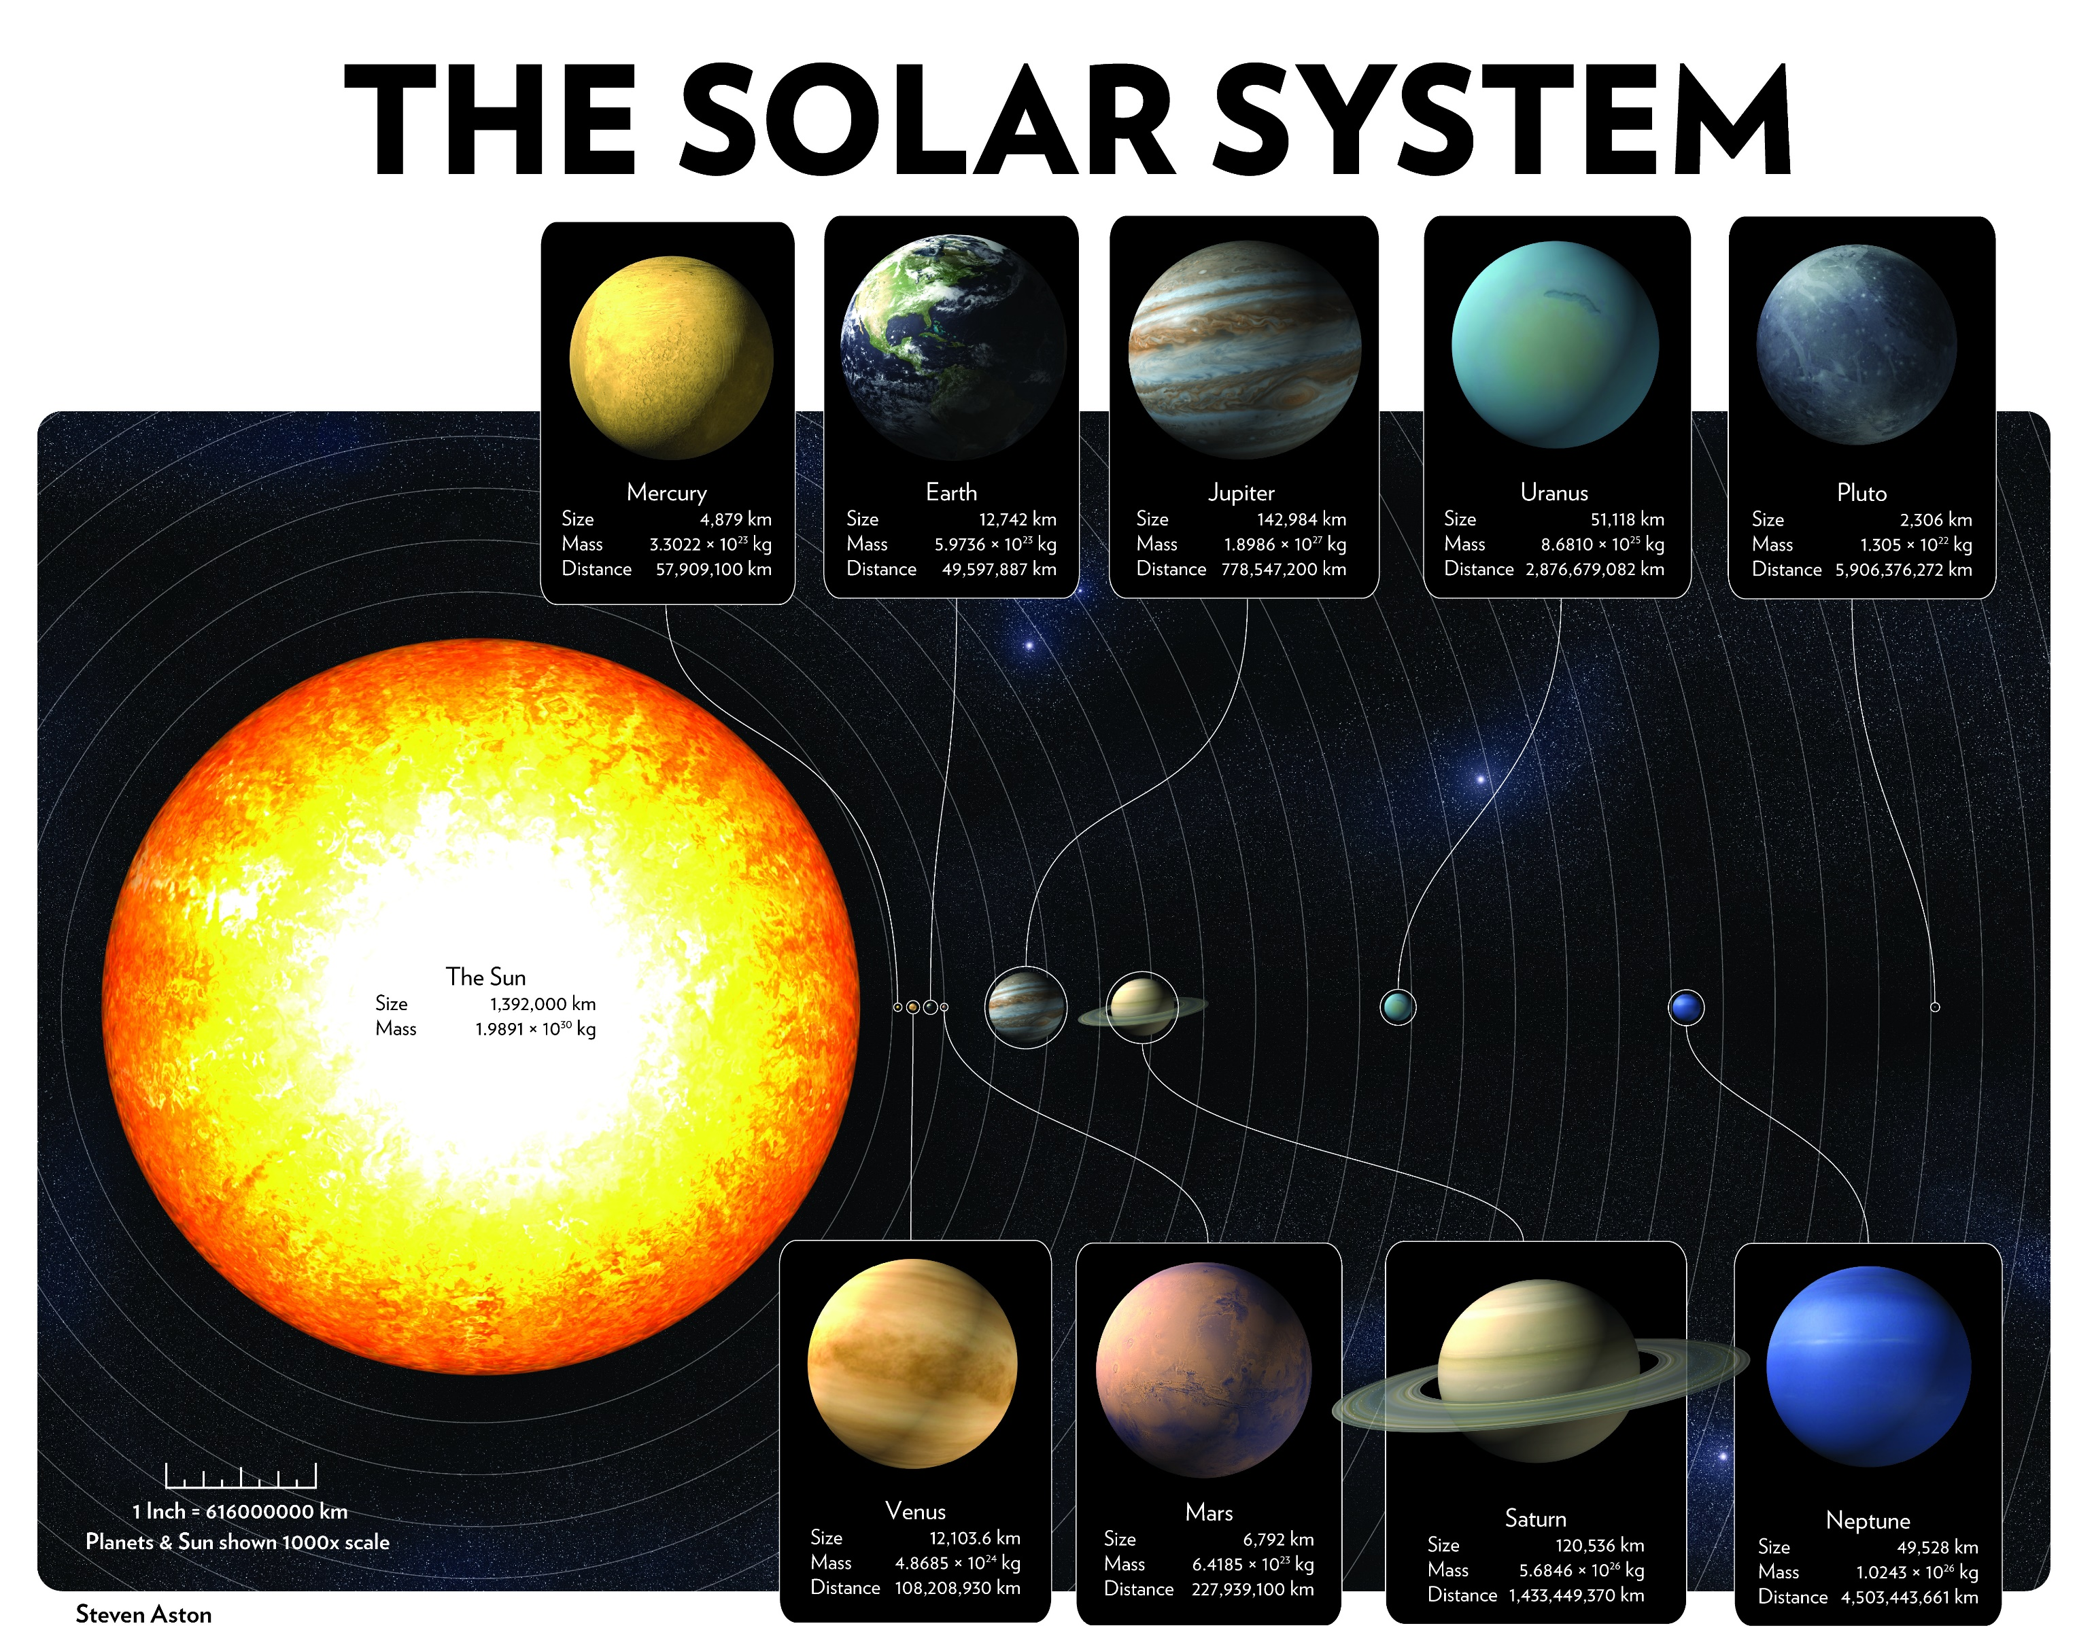
Mercury
Mass: 3.3×10²³ kg
Radius: 2,439,766 m
Moons: 0
Earth
Mass: 5.9×10²⁴ kg
Radius: 6,371,393 m
Moons: 1
Jupiter
Mass: 1.9×10²⁷ kg
Radius: 69,911,513 m
Moons: 53
Uranus
Mass: 8.7×10²⁵ kg
Radius: 25,361,652 m
Moons: 27
Pluto
(Dwarf Planet)
Mass: 1.3×10²² kg
Radius: 1,187,052 m
Sun
Mass: 2.0×10³⁰ kg
Radius: 695,700,099 m
Venus
Mass: 4.9×10²⁴ kg
Radius: 6,051,133 m
Moons: 0
Mars
Mass: 6.4×10²³ kg
Radius: 3,389,278 m
Moons: 2
Saturn
Mass: 5.7×10²⁶ kg
Radius: 58,232,503 m
Moons: 53
Neptune
Mass: 1.0×10²⁶ kg
Radius: 24,621,354 m
Moons: 13

