Slide 1
The Life of a Star

Slide 2
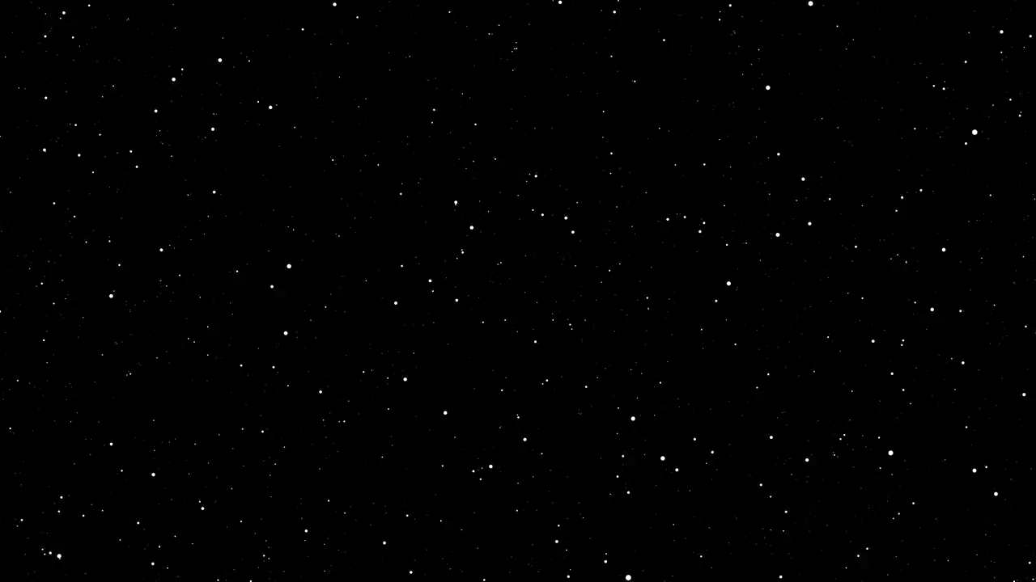
The Turko Tatar tribe believed that the world was naturally bright. But, in order to give his children a peaceful night’s sleep, they believed that God covered the world each night with a tent. The nighttime stars were simply holes in the fabric. After all, it is a very old tent.

Slide 3
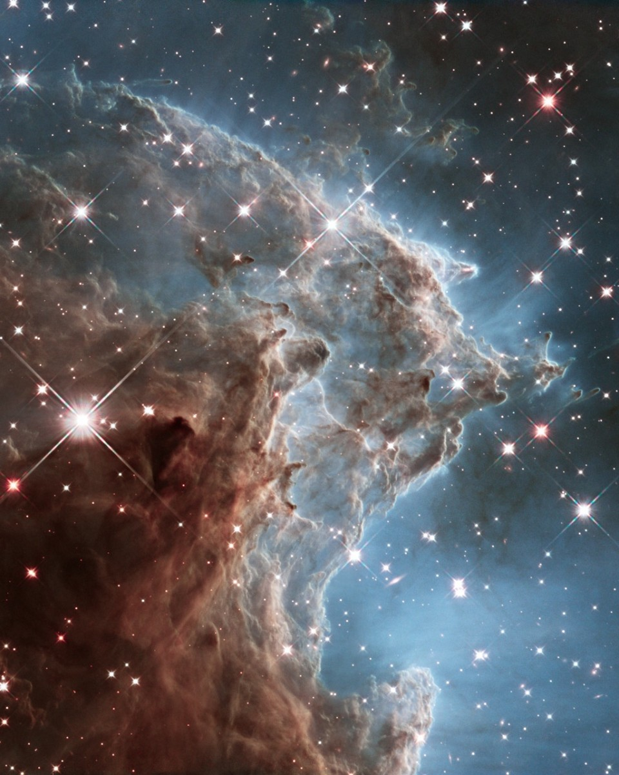
A Stellar Cloud (Hubble, 2012)

Slide 4
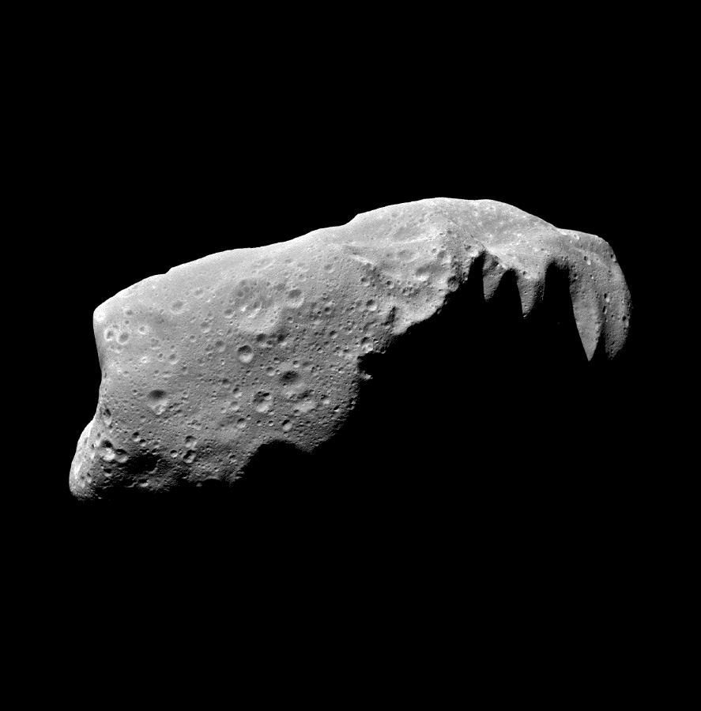
Asteroids, Meteors, Comets
“space rocks”

Slide 5

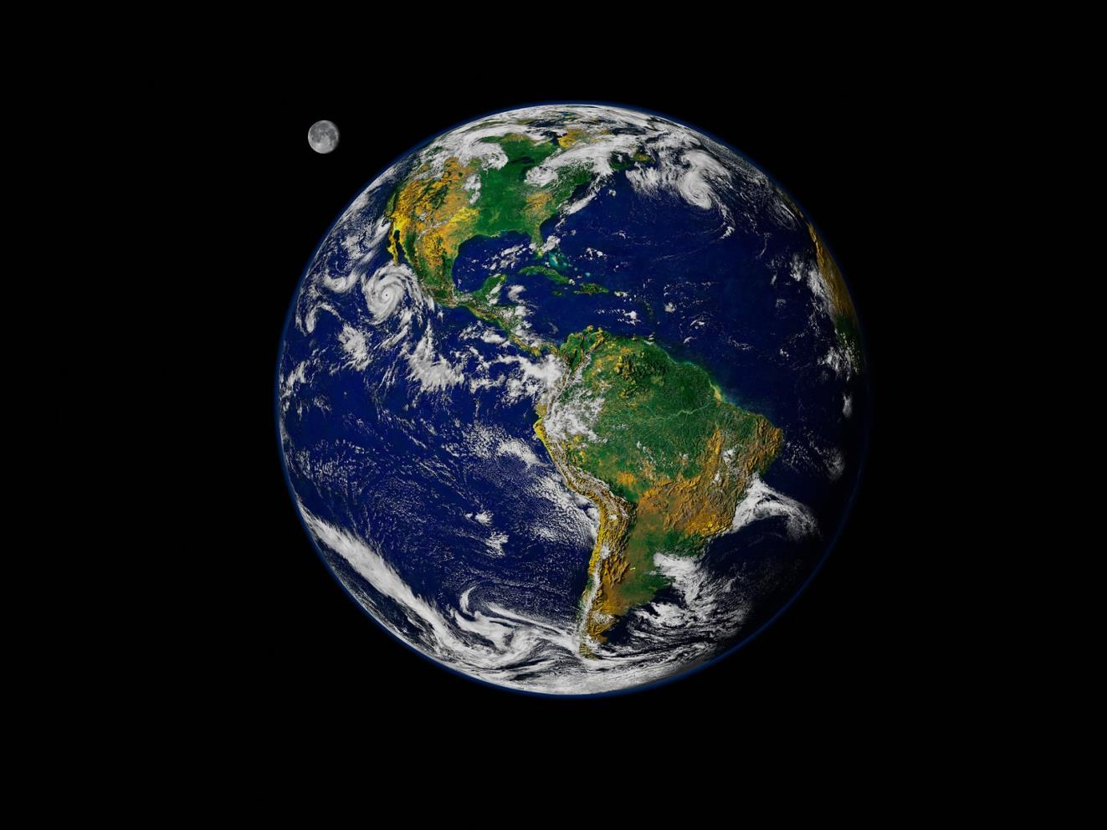
Asteroids, Meteors, Comets
“space rocks”
Planets and Moons
“enough gravity to be round”

Slide 6
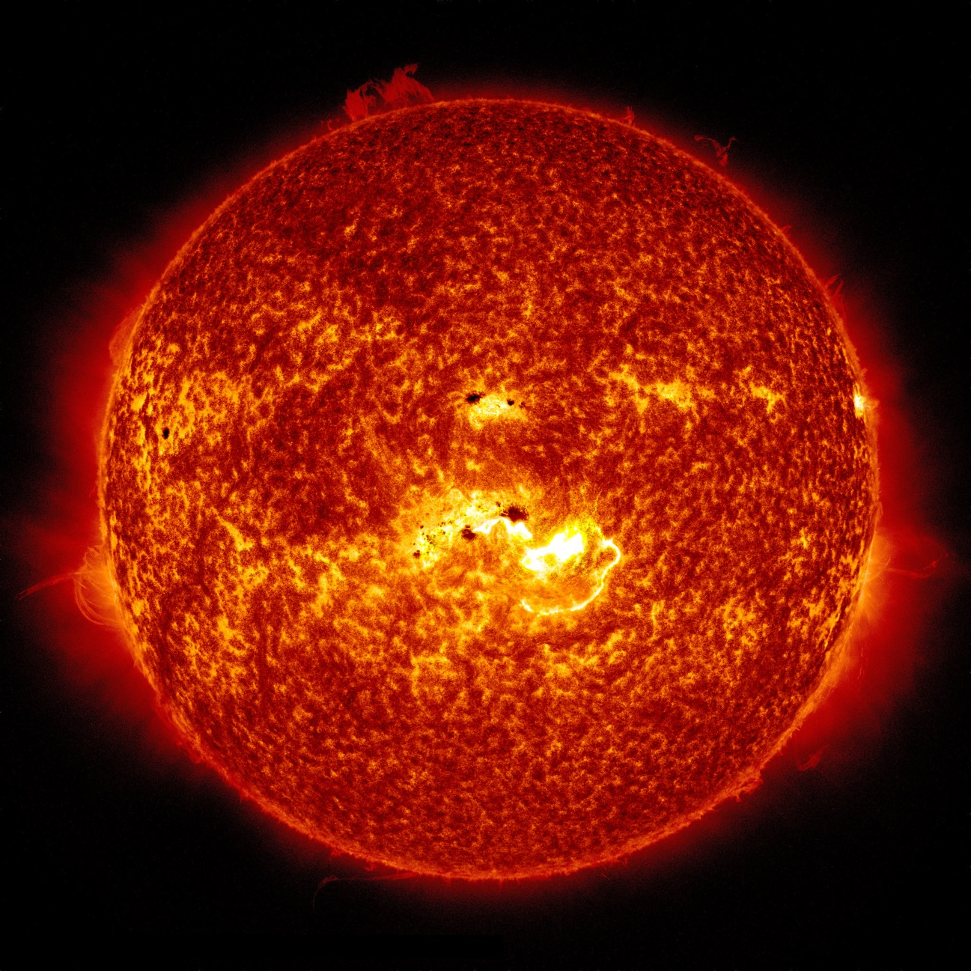
Asteroids, Meteors, Comets
“space rocks”
Stars
“so much pressure from gravity,
that they get super duper hot
and the atoms start to combine”
Planets and Moons
“enough gravity to be round”

Slide 8
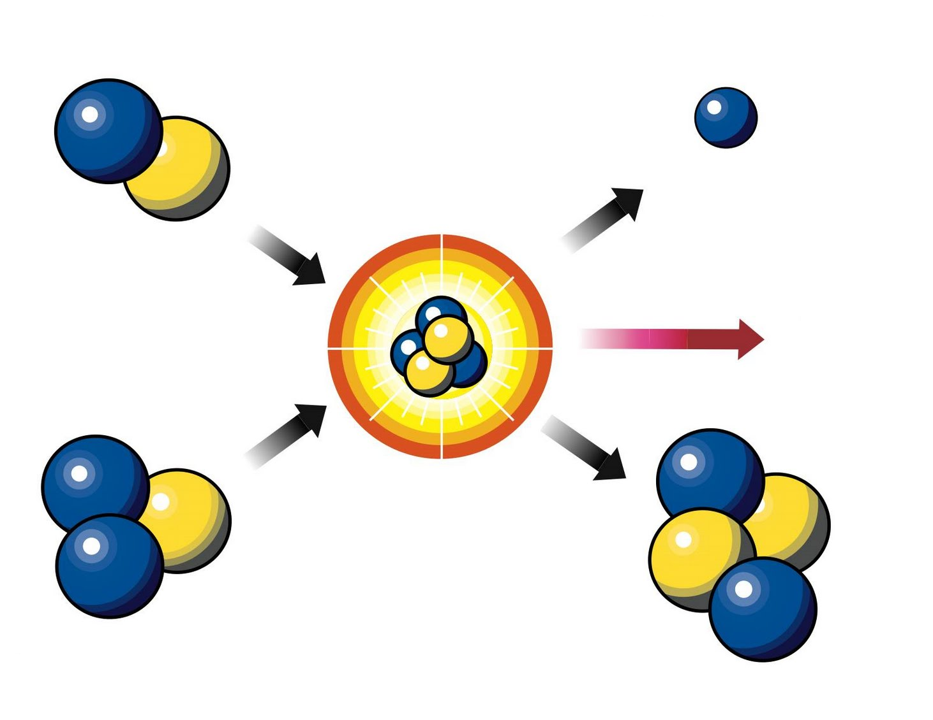
Fusion Inside a Star
Hydrogen
Extra Neutron
Energy
Helium
Hydrogen

Slide 9
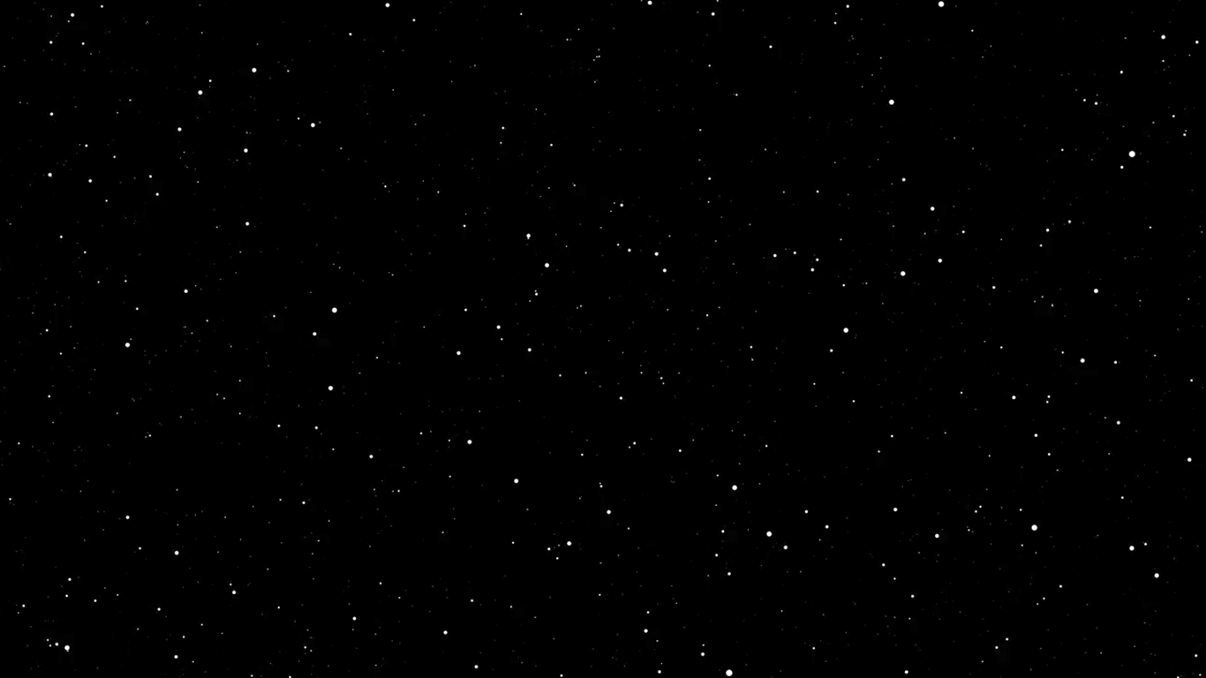
Notes:
Explain that our sun is a star and that stars are fixed (use cars analogy, driving at same speed but different distances… what if you didn’t know how big the car was?)

Slide 10
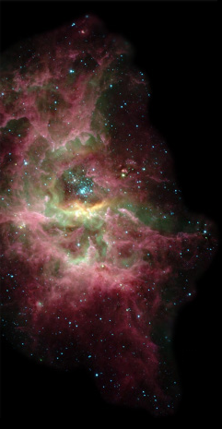
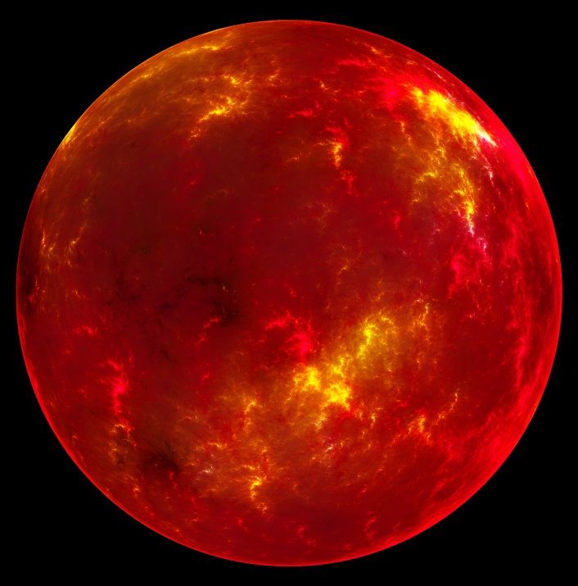
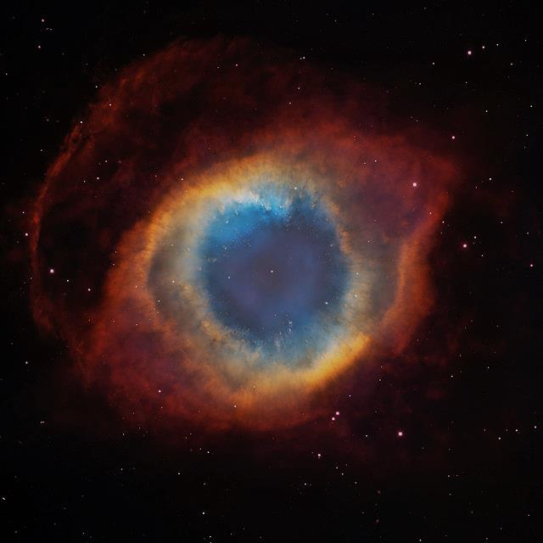
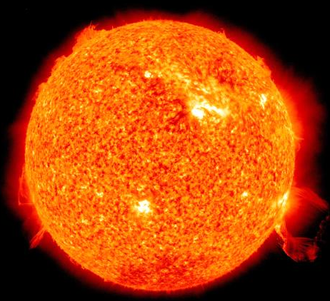
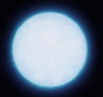
The Life Cycle of a Star…

Slide 11
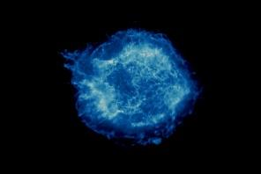
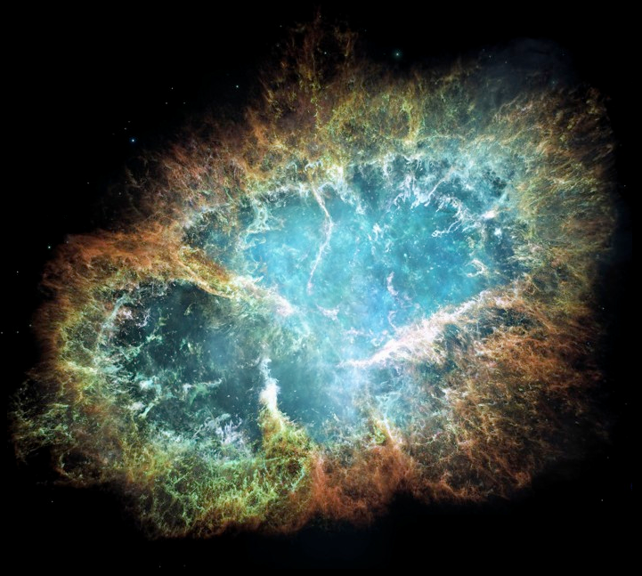

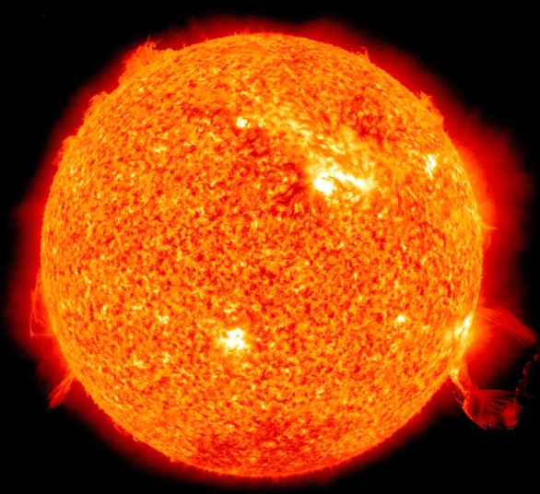
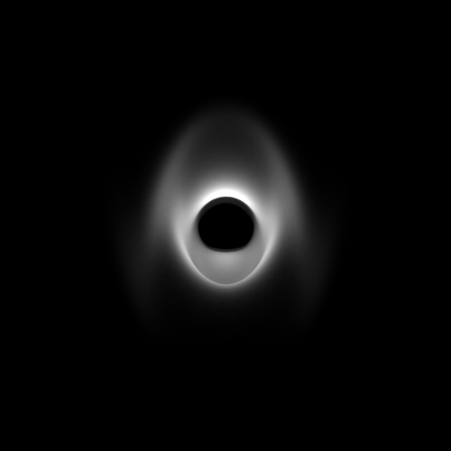
The Life Cycle of a Star…

Slide 12
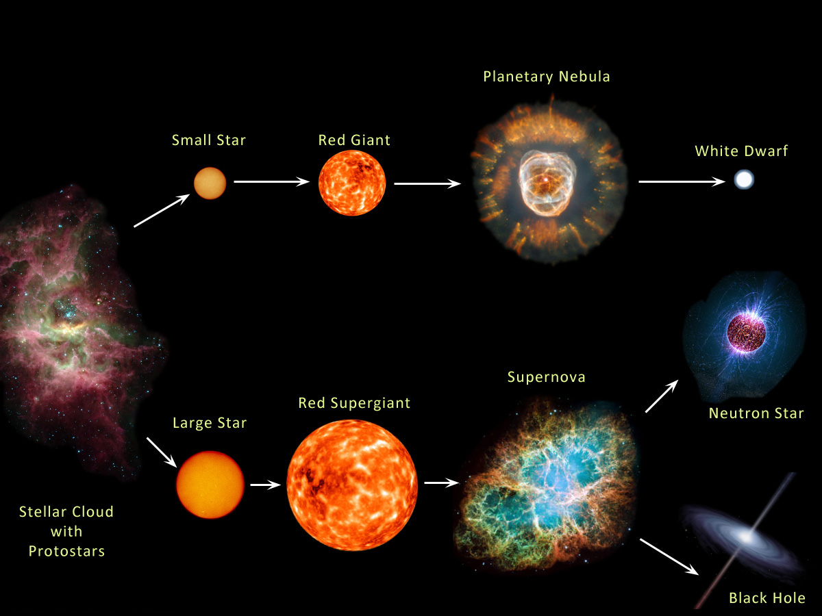

The Life Cycle of a Star…

